Slide 1
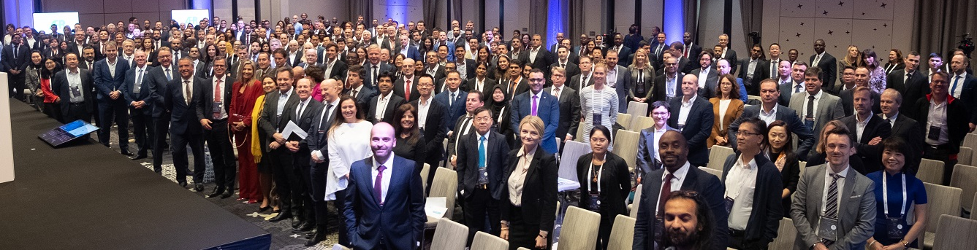
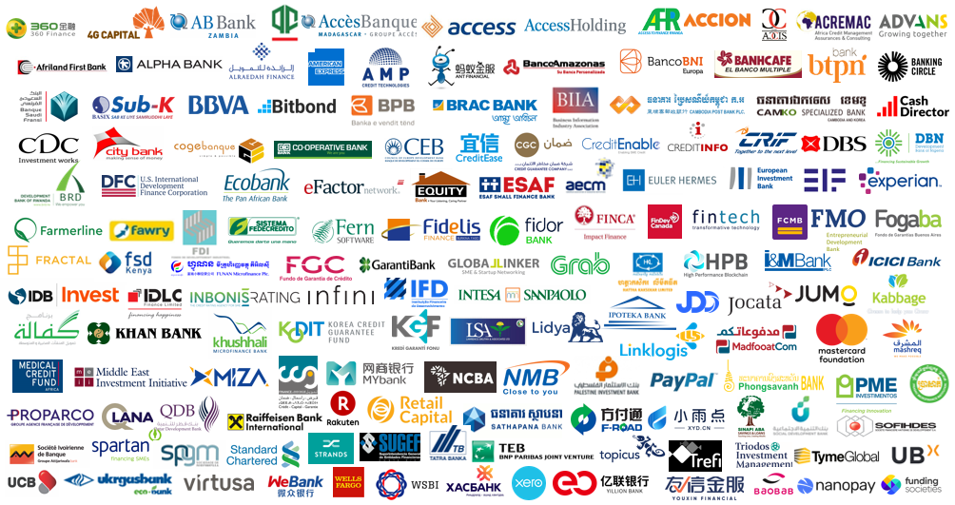
SME Finance Forum
Convening 230+ members from 60+ countries, operating in 190+ countries sharing knowledge, spurring innovation in & promoting growth of SME financing.
Created by G20 – Managed by

Slide 2
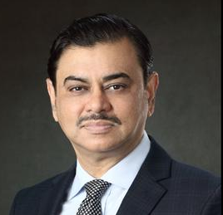
Member Benefits
LEARN
LINK
LEAD
Communities of practice
Immersion Programs
Study Visits
Online library/Publications
LinkedIn discussions
Monthly webinars
Global/ regional & partner events
Fintech expo/demo
Tips from experts
SME data
Networking
Contacts brokering
B2B marketplace
Connecting industry with policy-makers
Voice in key policy bodies -G20, AFI, APEC/ ABAC, Basel institutions, OECD
Being a member of the SME Finance Forum gives us insight into innovations around the world. Selim R. F. Hussain, CEO, BRAC Bank

Slide 3
Member Pulse Survey
Respondents by Region
2021 Q2
104 respondents
headquartered in 51 economies
with operations in 192 economies
2022 Q1
118 respondents
headquartered in 58 economies
with operations in 181 economies
*Data are not strictly comparable, unless specified, as they are based on data reported by varying sets of members

Slide 4
Member Pulse Survey
Respondents by Type of Institution
2022 Q2 cycle had 83 respondents who are lenders and 35 respondents who are non-lender.

Slide 5
Member Pulse Survey
Digital Transformation
Number of customers and sales that originated through digital channels in the past six months?

Slide 6
Member Pulse Survey
What MSME client operations have been fully digitalized as a result of COVID-19?
Others include documents exchange and storage, field project partner coordination, loan guarantee issuance process , bill payments, training and capacity building session

Slide 7
Member Pulse Survey
Has COVID-19 pushed you to adopt one of these technologies as part of the digitalization of your processes and services?

Slide 8
Member Pulse Survey (Q1 2022 )
Have you partnered with a FinTech company to offer new digital financial product/services to your MSME client?

Slide 9
Member Pulse Survey (Q1 2022)
In the next 6 months, what do you expect to happen to your revenue?
*This question was addressed to all members (lenders and non-lenders) in 2021, but in 2022 it was addressed only to non-lenders. Also, in 2021 the question asked about the next quarter, as opposed to the next six months in 2022.

Slide 10
Member Pulse Survey (Q1 2022)
In the next 6 months, what do you expect to happen to the number of your active customers?
*This question was addressed to all members (lenders and non-lenders) in 2021, but in 2022 it was addressed only to non-lenders. Also, in 2021 the question asked about the next quarter, as opposed to the next six months in 2022.

Slide 11
Member Pulse Survey (Q1 2022)
What is your current level of operations as % of the pre-crisis levels?
How long do you expect it will take for operations to reach pre-crisis level?

Slide 12
Member Pulse Survey (Q1 2022)
Digital Transformation
To what extent has the crisis accelerated the digital transformation of your operations?

Slide 13
Member Pulse Survey (Q1 2022)
What are your current loan collection level as % of pre-crisis levels?
What are your current loan disbursement level as % of pre-crisis levels?

Slide 14
Member Pulse Survey (Q1 2022)
Main reasons for the decline in lending compared to pre-crisis levels

Slide 15
Member Pulse Survey (Q1 2022)
What types of liquidity pressures have you experienced since the pandemic?
Others include delayed repayments of loans, increase of SWAP cost, etc.

Slide 16
Member Pulse Survey (Q1 2022)
Credit Guarantee
Have you leveraged credit guarantees to support your new loan originations since the pandemic?
What share of your current portfolio is supported by credit guarantees?

Slide 17
Member Pulse Survey (Q1 2022)
Over the next twelve months, do you expect to leverage credit guarantees in support of your new loan originations?

Slide 18
Member Pulse Survey (Q1 2022)
The most important factors that may hinder your ability to meet new demand from SMEs over the next 12 months.

Slide 19
Member Pulse Survey (Q1 2022)
How would you rate current demand for new MSME loans compared to pre-crisis levels?

Slide 20
Accelerating finance
for businesses
Connect with us
www.smeﬁnanceforum.org
Twitter: @smefinanceforum
LinkedIn: SME Finance Forum

